Slide 1


Department of Information and Communication Technology
Diploma Studies
Marwadi University
Name: Nilay Narendra Bhai Dhruv
Roll Number: 92300957018
Semester: 6th
Subject: PROJECT II (09CT0602)
Domain of Project : Web Application
Title: Smart Online Exam Monitoring System
Guide Name: Prof. Chirag Visani
Student passport size photo only

Slide 2
1. Introduction
Introduction to the Project
The Smart Online Exam Monitoring System is an online examination platform that monitors students during exams using a webcam. It helps conduct exams securely by checking student moment in real time.
Importance in the Current Scenario
With the increase in online education and remote exams, cheating has become a major concern. Traditional online exams lack proper supervision. This system helps maintain fairness and honesty in online exams.
Real-World Application
This system can be used by schools, colleges, universities, and training institutes to conduct secure online exams. The project was chosen to solve real problems like cheating, and lack of monitoring in online examinations.

Slide 3
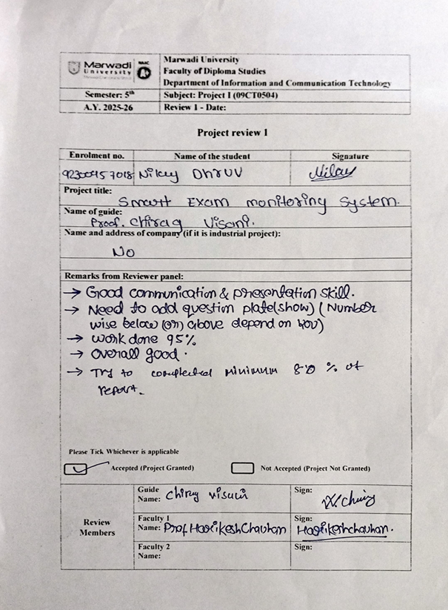
Previous Review cards
Review Card 1

Slide 4
2. Problem Statement
Problem Definition
Online exams often lack proper supervision, which makes it easy for students to cheat by looking away, switching tabs, or letting someone else take the exam. There is no reliable way to monitor students remotely.
Scope and Boundaries
This project focuses on monitoring students during online exams using a webcam and browser activity. It detects face absence, head movement, and tab switching.It does not deal with physical exam centers or offline examinations.
Significance of the Problem
Ensuring fairness and honesty in online exams is very important for education systems. Without proper monitoring, exam results may not be trustworthy. Solving this problem helps maintain exam integrity and improves the credibility of online assessments.

Slide 5
3. Literature Survey
Overview of Existing Systems
Several online exam Monitoring systems already exist to monitor students during online exams. These systems mainly focus on webcam monitoring, screen recording, or AI-based behavior analysis.
Methods Used in Existing Solutions
Some systems use live human proctors to watch students through webcams.
Some use AI-based face detection to check if the student is present.
Other tools monitor screen activity, such as tab switching or opening other applications.
A few systems record the entire exam session for later review.
Gaps and Limitations
Human proctoring is costly and time-consuming.
Some AI systems only detect face presence and do not track head movement or behavior.
Many systems are heavy, require high internet speed, or are difficult to deploy.
Limited automation in warning and exam termination.

Slide 6
3. Literature Survey
Existing App | What It Does | Problems | How My Project Solves It
Zoom / Google Meet | Teacher watches students using webcam | Needs many teachers, very costly | No human needed, fully automatic
ProctorU | AI + human monitoring | Paid and expensive | Free, simple, and secure system
Examity | Records and reviews student behavior | No instant action, slow process | Gives real-time warnings
Mercer Mettl | Webcam-based exam monitoring | Heavy system, complex setup | Lightweight and easy to use
LockDown Browser | Blocks other tabs | No webcam monitoring | Uses webcam + tab detection
Google Forms Exams | Only login and timer | No security, easy cheating | Full monitoring during exam
Recorded Proctoring | Records exam for later checking | Cheating found after exam | Stops cheating during exam

Slide 7
4. Objectives of the Project
Main Objective
To develop a secure and automated online exam system that monitors students in real time and prevents cheating during online examinations.
Sub-Objectives
To monitor student behavior using webcam and detect suspicious actions
To track tab switching and generate automatic warnings
To auto-submit or terminate the exam after repeated violations
Uniqueness of the Project
Fully automated Monitoring without human involvement
Combines webcam monitoring and browser activity tracking
Lightweight, easy to use, and cost-effective system

Slide 8
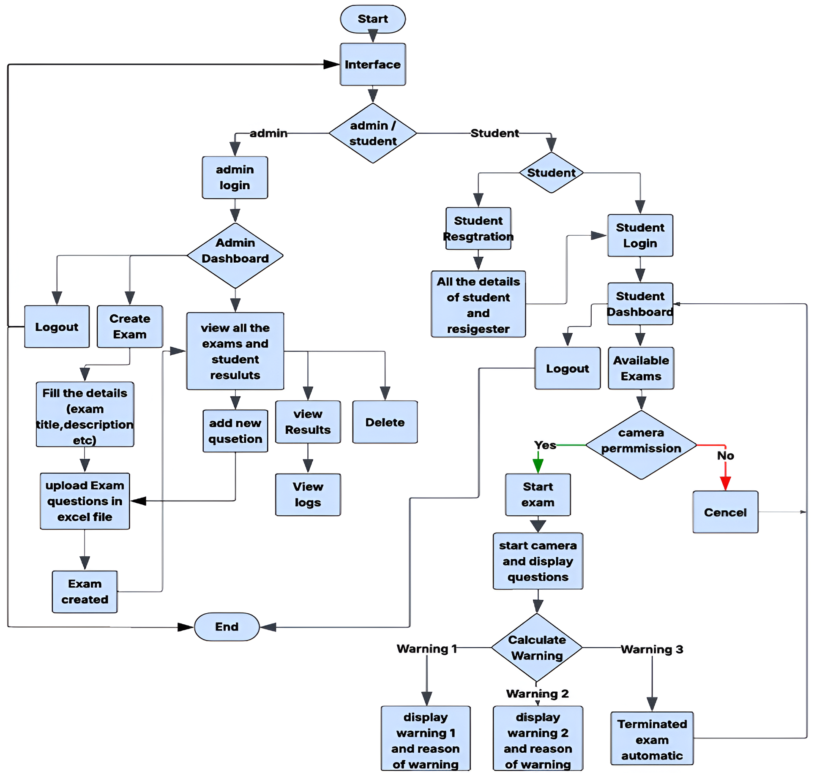
5. Proposed Work
Flowchart

Slide 9
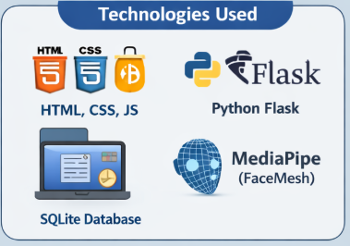
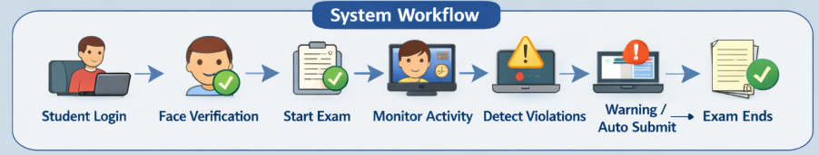
Proposed Work
Technologies Used
Frontend: HTML, CSS, JavaScript
Backend: Python Flask
Database: SQLite
Webcam Monitoring: MediaPipe (FaceMesh)
Question Handling: Excel parsing using openpyxl
Face detection
Detect Other activities

Slide 10
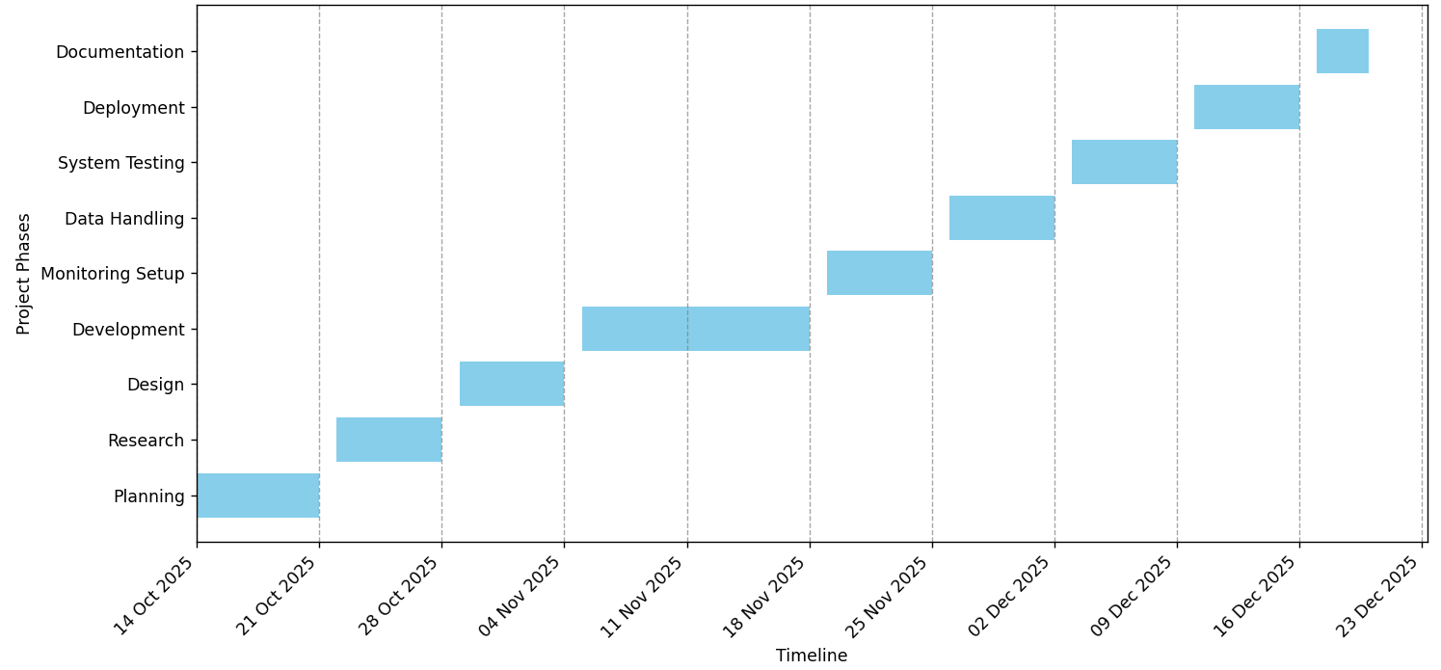
6. Work Plan & Timeline

Slide 11
Work Plan & Timeline
Feature | Description | Status
User Registration & Login | Secure login for admin and students | Completed
Admin Exam Creation | Create and schedule exams | Completed
Question Upload | Upload Excel files | Completed
MCQ Extraction | Automatic question extraction | Completed
Student Exam Interface | Exam page with timer | Completed
Face detection | Face check before exam | Completed
Webcam Monitoring | Face presence & head movement detection | Completed
Tab Switch Detection | Detect browser tab switching | Completed
Warning System | Auto warnings for violations | Completed
Auto Exam Submission | Auto-submit after violations | Completed

Slide 12
Work Plan & Timeline
Result Generation | Automatic result calculation | Completed
Violation Logs | Store monitoring logs | Completed
Admin Reports | View results and violations | Completed
System Testing | Check all the features | Completed
Deployment | Deployed in cloud | Completed
Documentation | Report and PPT preparation | Completed

Slide 13
7. Interaction with Guide
Meetings:
Met the guide two times in a week
  One in-person meeting
  One phone call
Extra discussions were held during technical issues or important decisions
Category | Details
Key Suggestions | • Keep the exam interface simple and easy to use • Focus on real-time monitoring during exams • Add automatic warnings for violations • Ensure fair and secure examination process • Test the system with multiple users
Technical Inputs | • Use Flask framework for backend development • Use MediaPipe for face detection and monitoring • Implement tab-switch detection using JavaScript • Store data securely using SQLite database • Improve system performance through testing

Slide 14
8. Problem Faces
Problem Faced | How I Solved It
Face not detected properly during the exam | Improved camera positioning and lighting conditions
Tab switching not detected properly | Improved JavaScript event handling and tested on different browsers
Automatic warning count increased even after exam submission | Fixed logic to stop monitoring once the exam is submitted
Webcam permission issues | Helped by chirag visani sir
Performance issues during real-time monitoring | Optimized code to reduce processing load

Slide 15
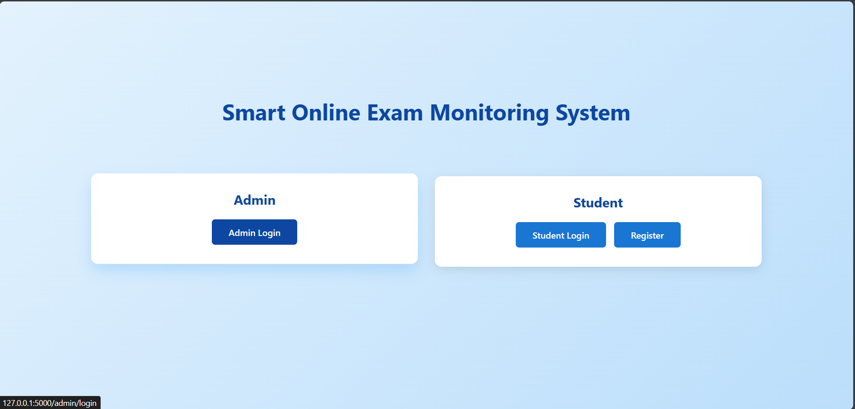
9.Work Done

Slide 16
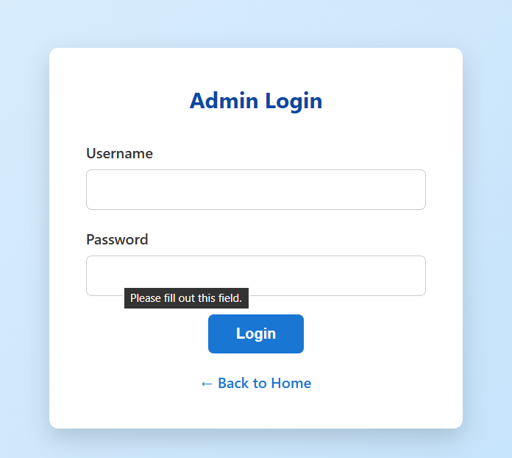
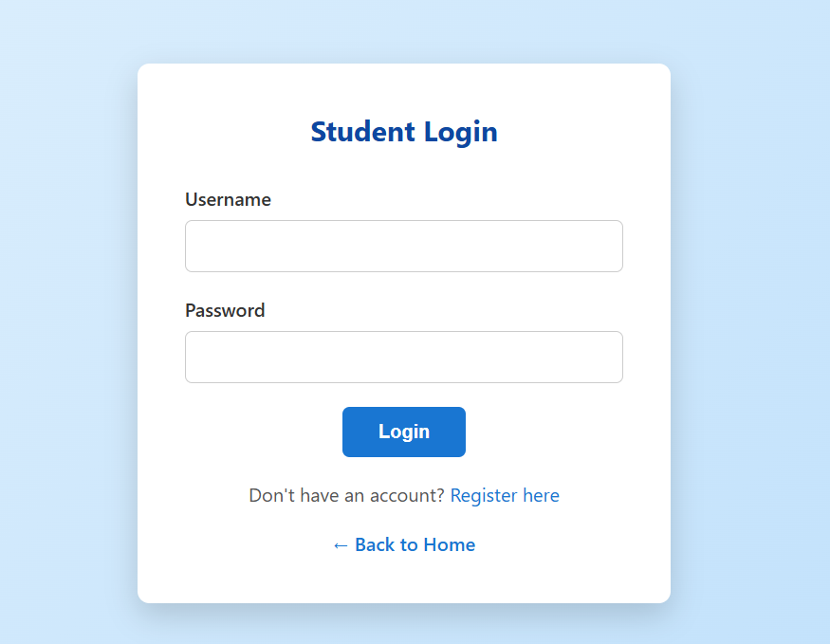
Admin/Student login

Slide 17
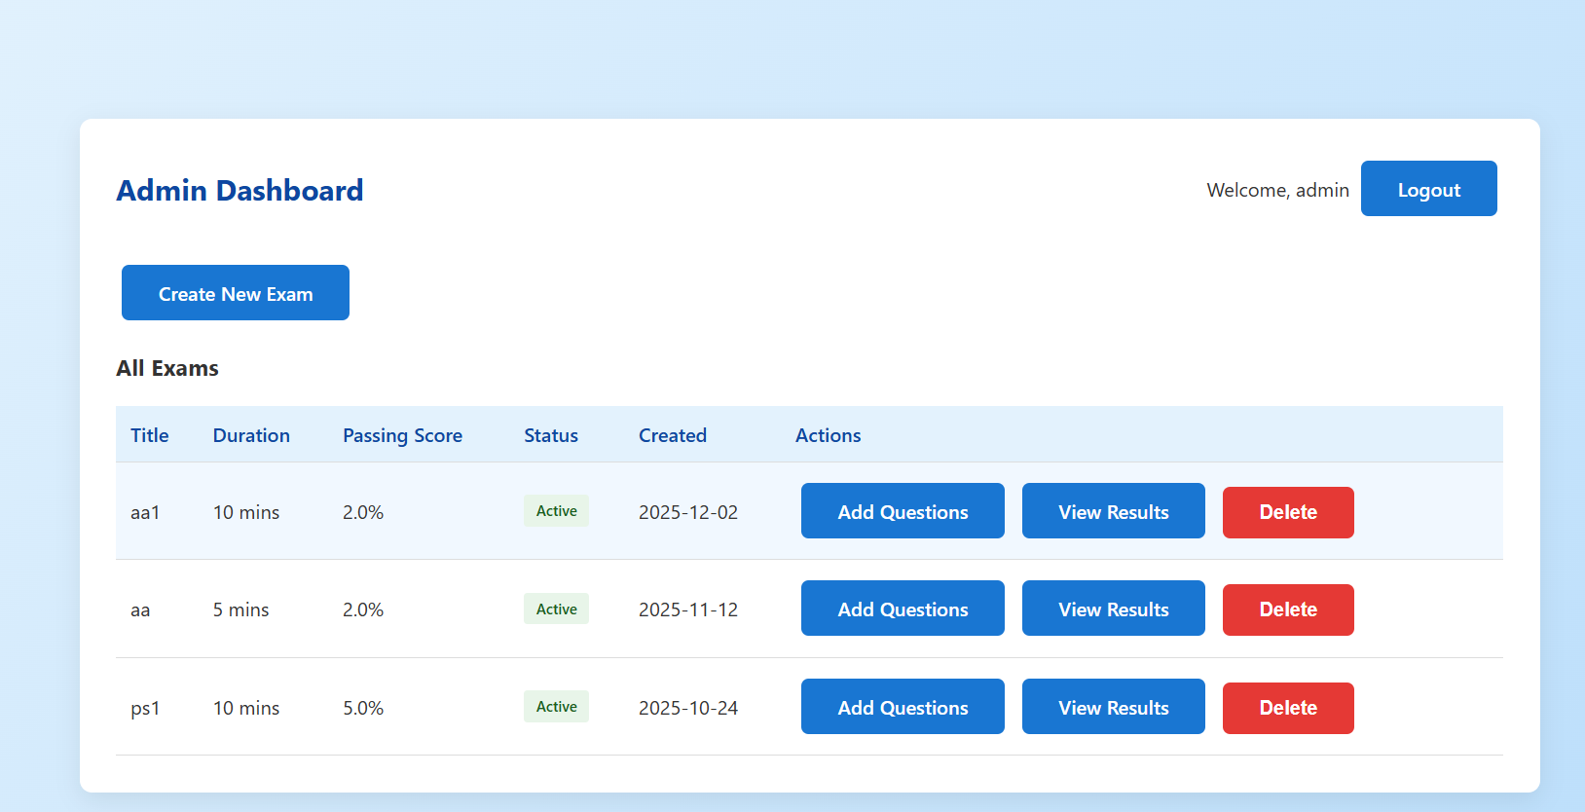
Admin Dashboard

Slide 18
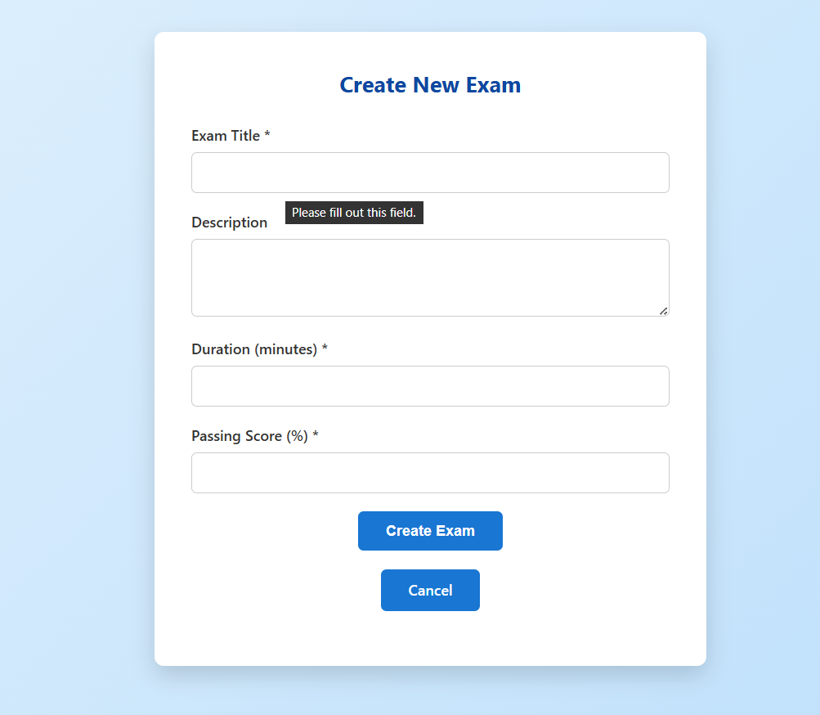
Create New Exam

Slide 19
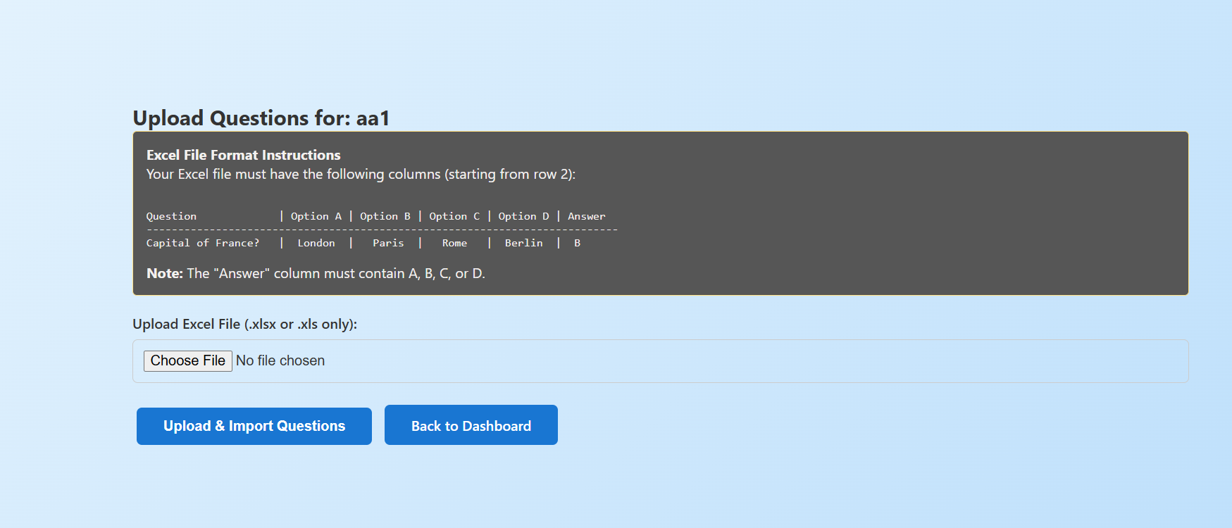
Upload and format

Slide 20
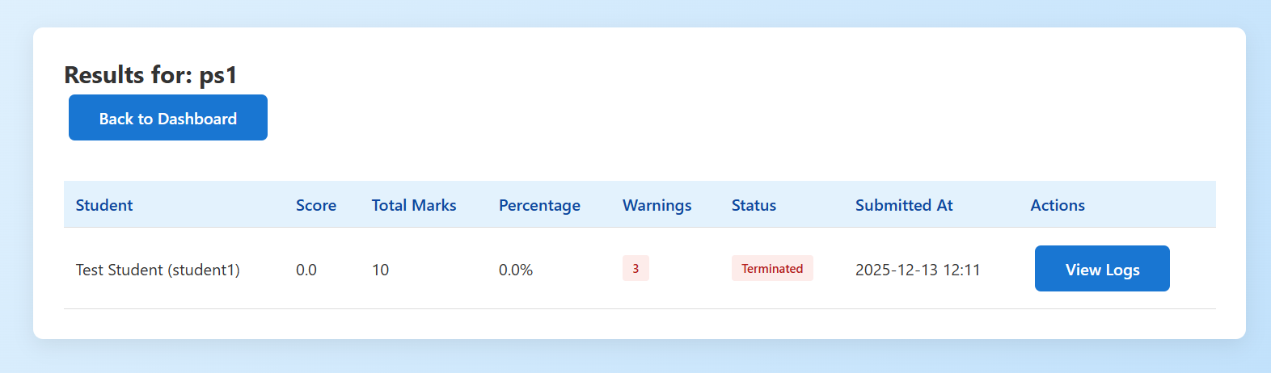
Student Result

Slide 21
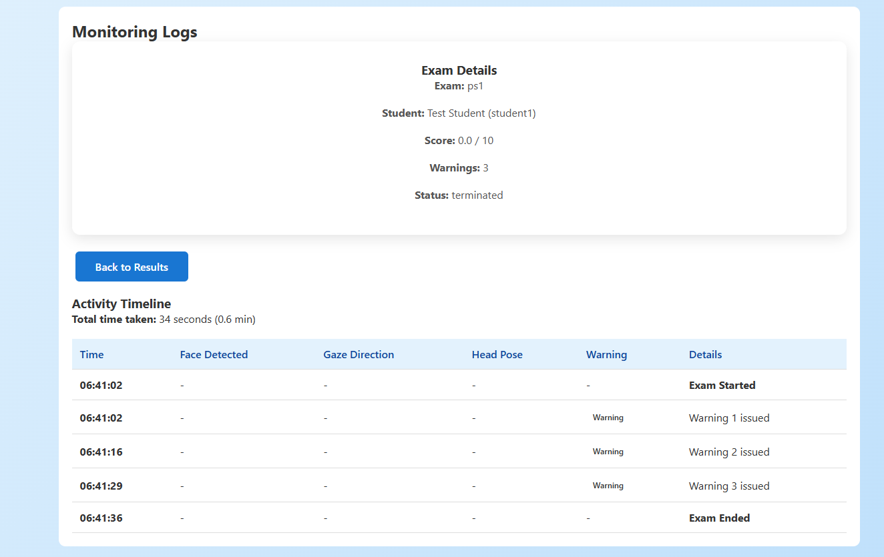
Student Logs

Slide 22
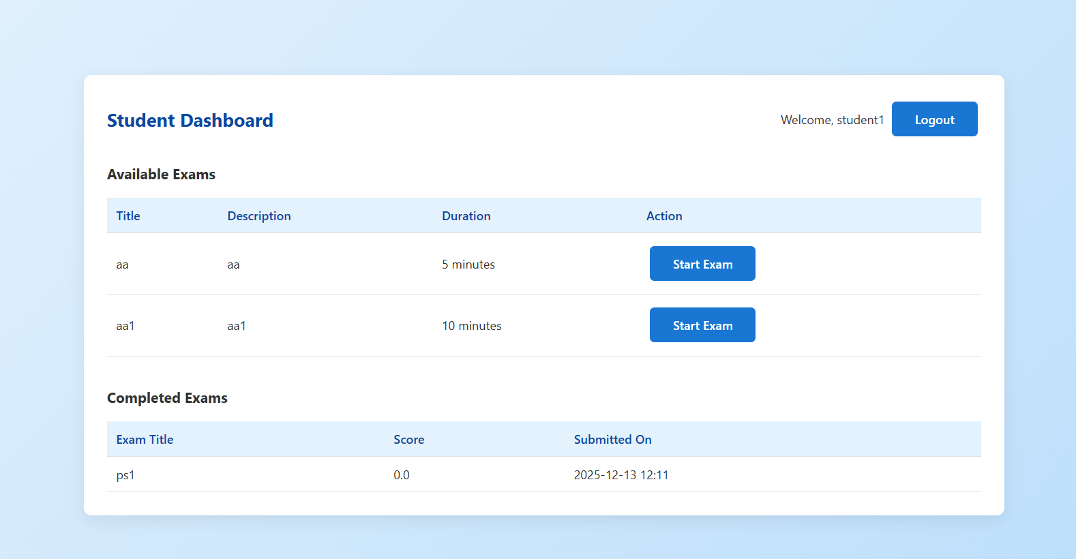
Student Dashboard

Slide 23
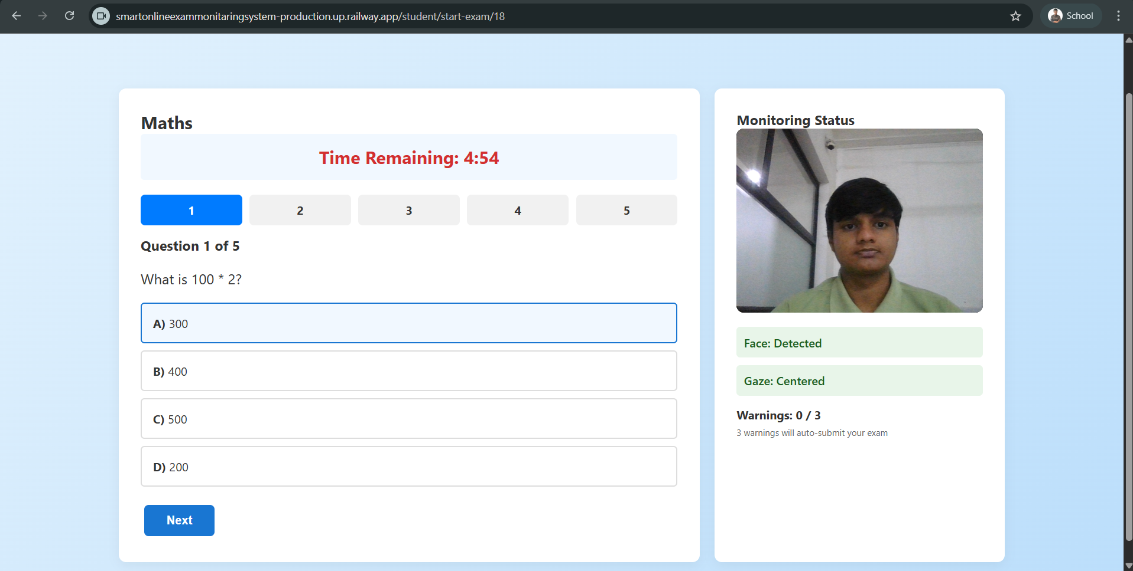
Exam view

Slide 24
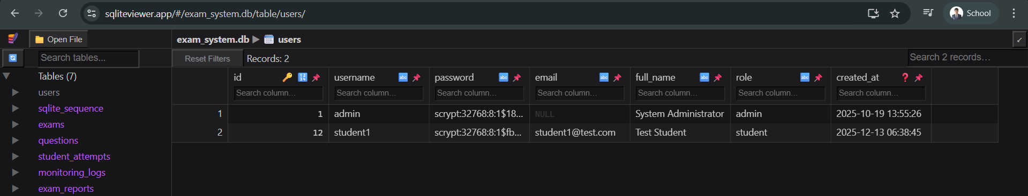
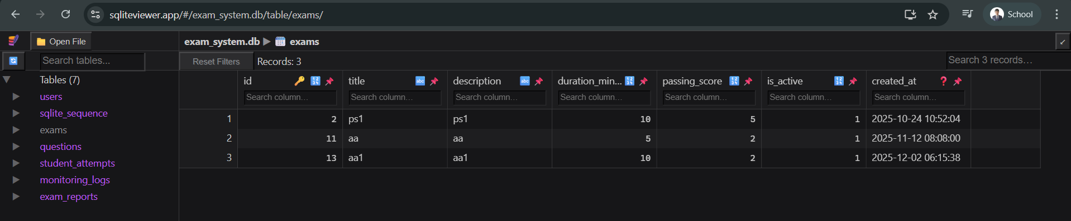
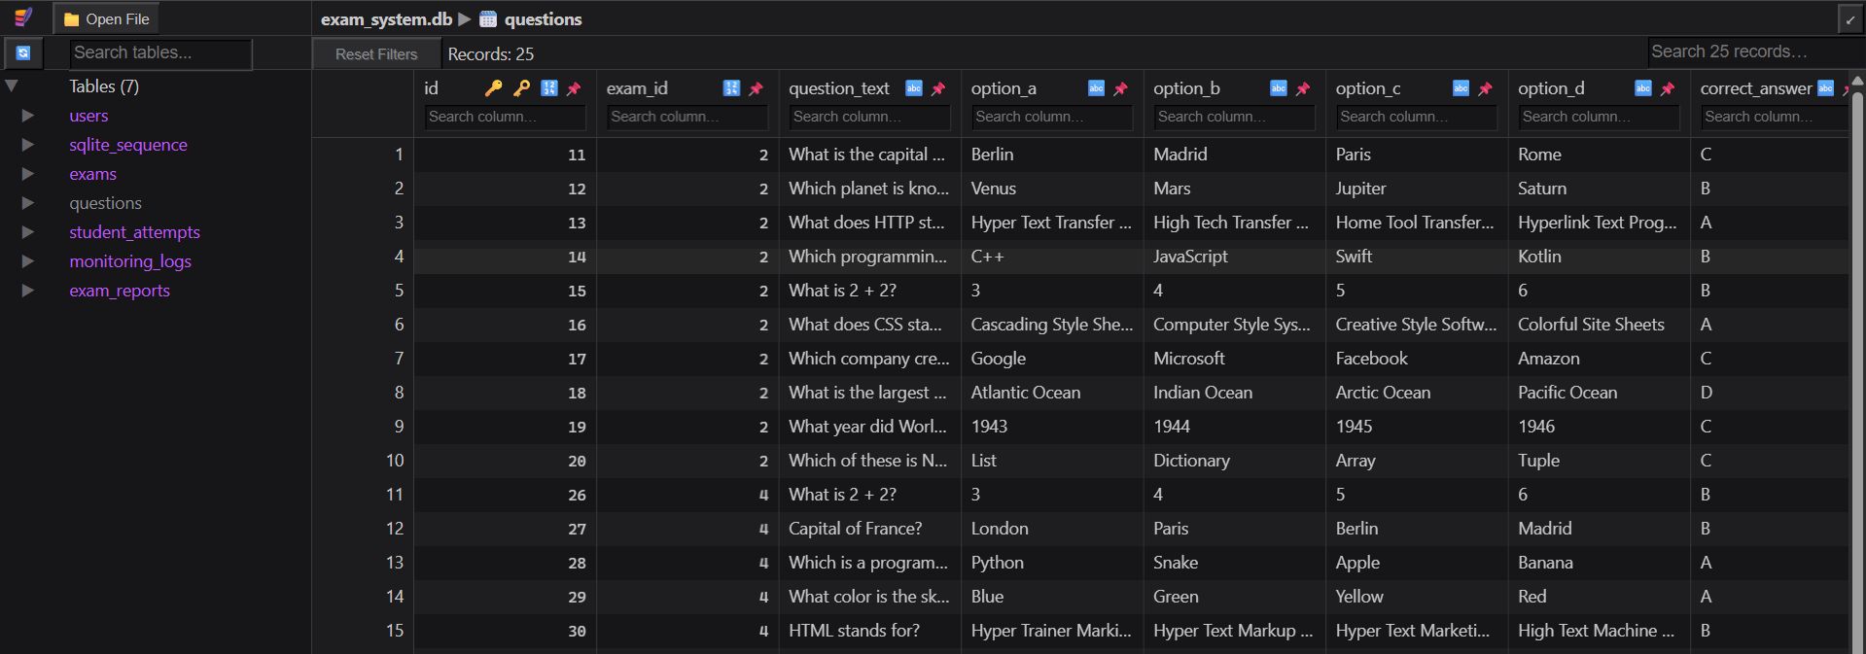
Database view

Slide 25
10. Conclusion & Way Forward
Conclusion
A smart online exam proctoring system was successfully developed
The system monitors students using webcam and browser activity
Face verification and real-time monitoring were implemented
Automatic warnings and exam submission were added
The system helps reduce cheating in online exams
Long-Term Outcome
Can be used by colleges and universities for online exams
Helps conduct secure and fair online examinations
Reduces need for human invigilators
Can be enhanced using advanced AI techniques in future
Deployed link: https://smartonlineexammonitaringsystem-production.up.railway.app/

Slide 26
References
1. Flask Documentation – Official Flask Web Framework Documentation
source : https://flask.palletsprojects.com/
2. MediaPipe Documentation – Google MediaPipe Framework source : https://developers.google.com/mediapipe /
3. SQLite Documentation – SQLite Database Engine
source : https://www.sqlite.org/docs.html/
4. Python Official Documentation
source : https://docs.python.org/3/

Slide 27
Thank you
Any Question ?

